Slide 1


MILESTONE II
Crypto Volatility and Risk Analyzer
TEAM B
A data-driven analytical system designed to study cryptocurrency price volatility and market risk. It automatically processes historical and real-time price data to compute key risk indicators. The system visualizes risk levels to support informed decision-making for investors and analysts.

Slide 2

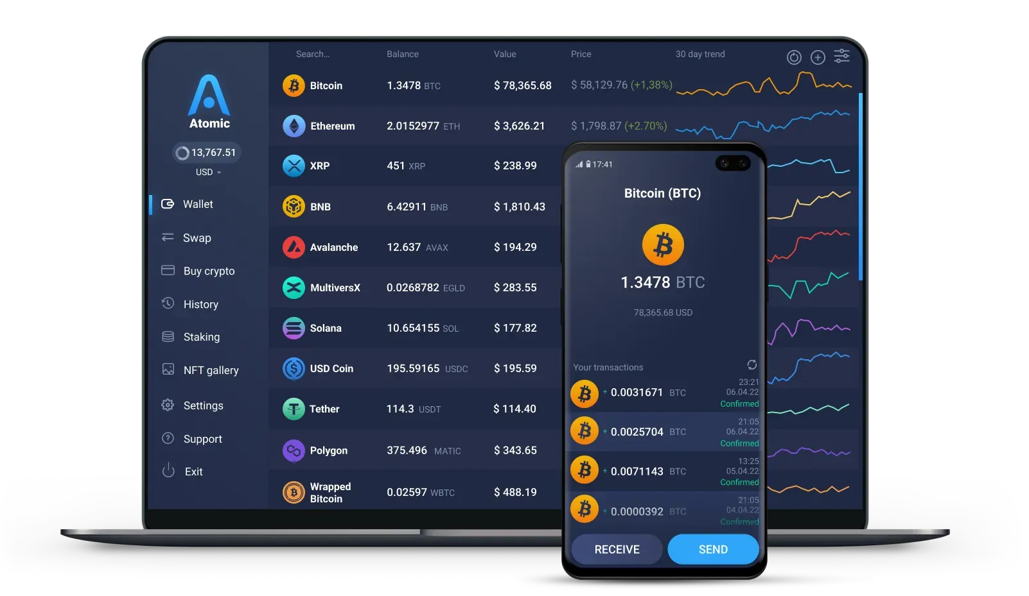
Dataset Description
Cryptocurrency historical price data collected using public CoinGecko Public API
Provides free access to real-time and historical crypto market data
Covers multiple cryptocurrencies over the last 30 days
Dataset includes date-wise price information used for volatility and risk analysis

Slide 3





Risk Score Calculation & Classification
01
Risk scores are calculated for all cryptocurrencies using historical price volatility
02
A composite risk score is derived from overall volatility and rolling volatility
03
Risk levels are dynamically classified using percentile-based thresholds
Final risk metrics and classifications are stored in a CSV file for dashboard usage
0 4

Slide 4

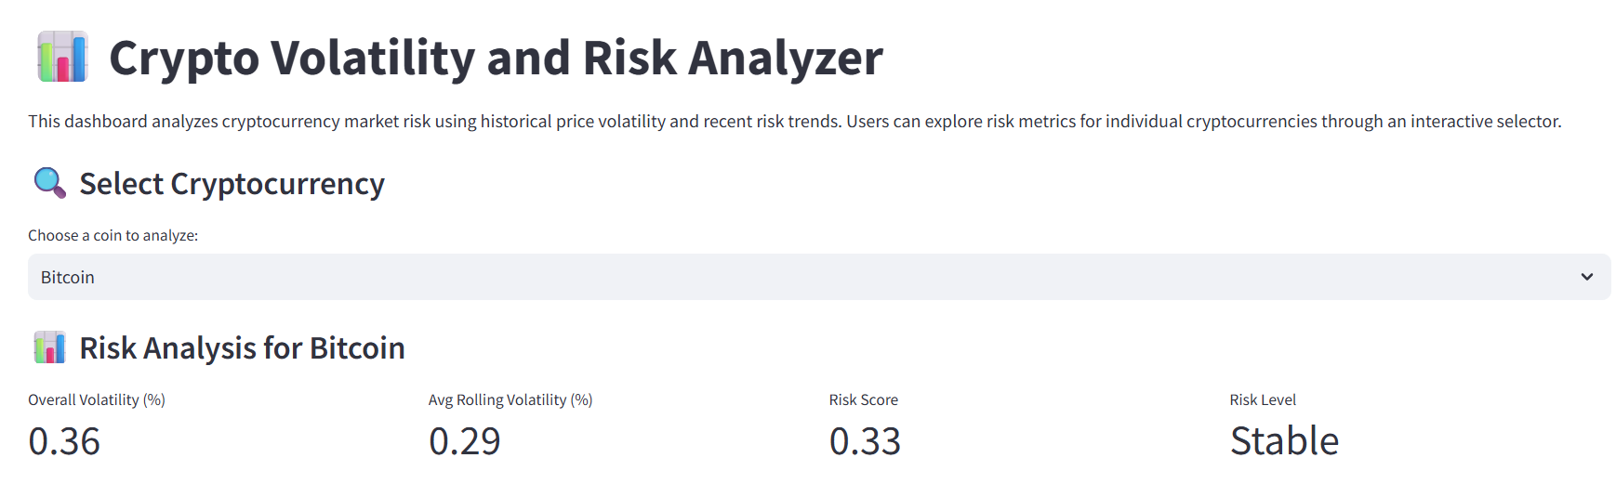
Coin Selector & Selected Coin Details
.
.
An interactive coin selector allows users to choose a cryptocurrency
Provides volatility, risk score, and risk level in a clear summary view
.
.
Displays key risk metrics specific to the selected coin
Enables focused analysis of individual cryptocurrencies

Slide 5


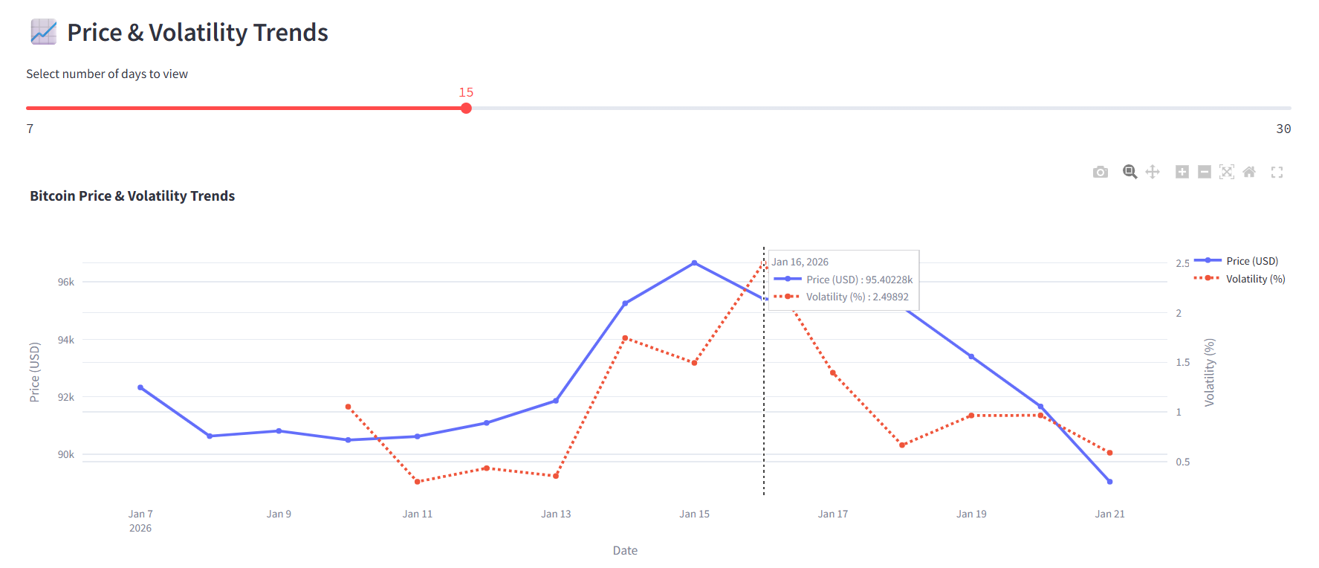



Price & Volatility Trends
01
Displays historical price movement of the selected cryptocurrency
02
Shows rolling volatility trend alongside price using a dual-axis graph
03
Interactive day selector allows users to view short-term or long-term trends
04
Helps identify periods of high price fluctuation and market risk

Slide 6
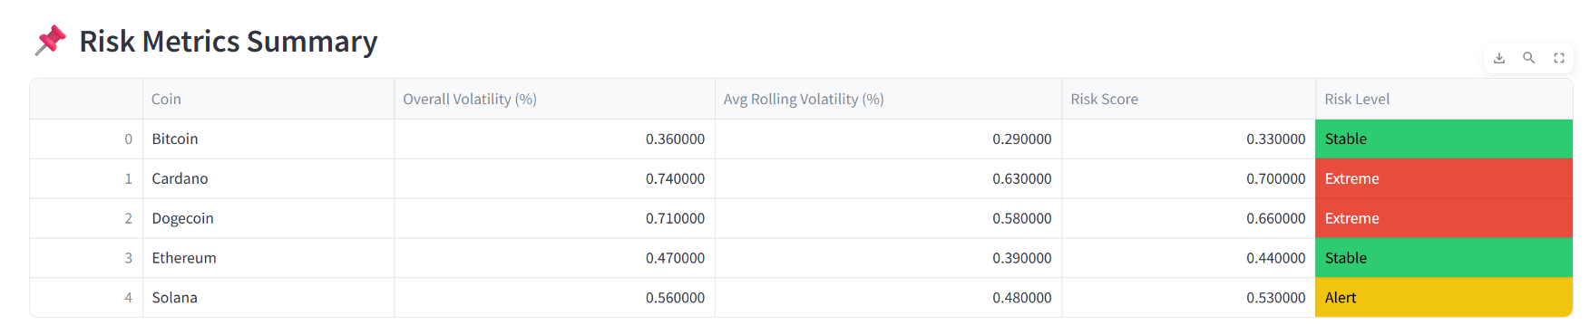
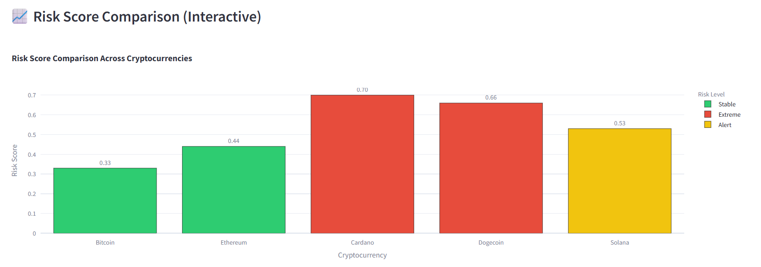
Risk Metrics Summary & Comparison
.
.
Displays calculated risk metrics for all selected cryptocurrencies
Risk levels are visually classified as Stable, Alert, and Extreme
.
.
Includes overall volatility, rolling volatility, risk score, and risk level
Interactive bar chart compares risk scores across cryptocurrencies

Slide 7



Thank You

